Slide 1
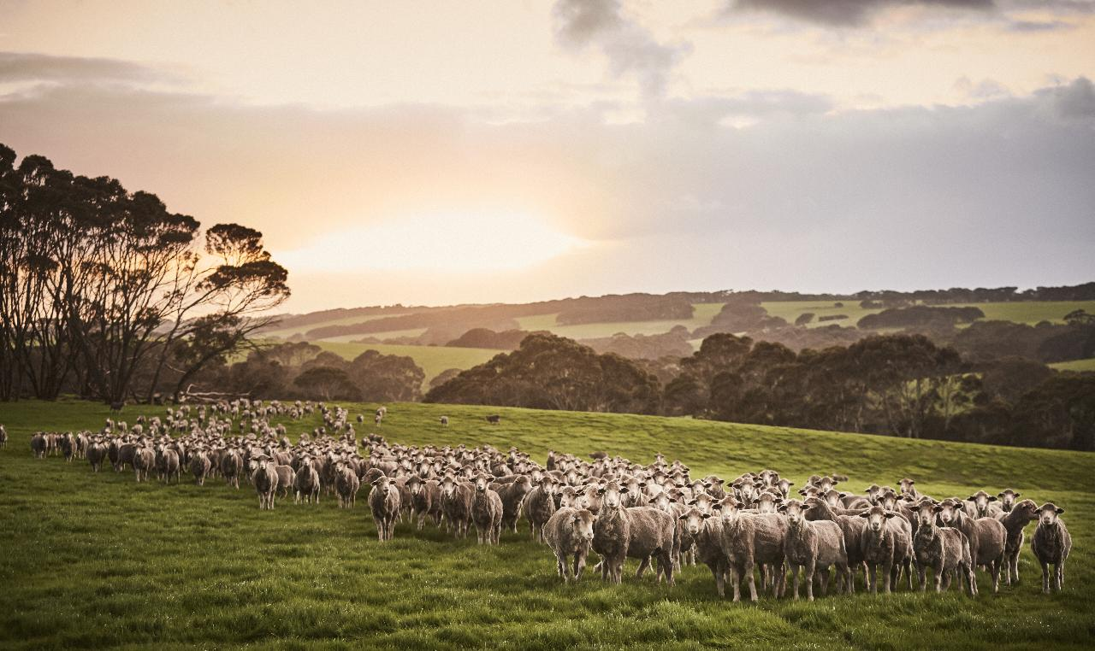

Australian Production & Global Demand for Wool
Stephen Feighan
Australian Wool Innovation
Notes:
Thank you for the opportunity to speak today and provide some insights to into Australian wool production, global trade and consumer demand

Slide 2
Australian Wool Production Forecast
PARAMETER | 2022/23 | 2023/24 | 2024/25e | 2025/26(f)
Opening Sheep Number (million) | 70.2 | 69.9 | 63.1 | 57.9
Sheep Numbers Shorn (million) | 71.5 | 71.6 | 63.0 | 56.5
Average Cut per Head (kg greasy) | 4.59 | 4.44 | 4.45 | 4.34
Shorn Wool Production (mkg greasy) | 328 | 318 | 280.1 | 251.5
Australian Wool Production Forecasting Committee (August 2025)
Estimate of shorn wool production for 2024/25 is 280.1 mkg greasy, 11.8% lower than the 2023/24 season estimate.
Second forecast of shorn wool production for the 2025/26 season is 251.5 mkg greasy, a 10.2% decrease on the 2024/25 estimate.
Notes:
Other speakers here today will update you on their own countries wool production – so on this topic I will focus on Australia.
Here are the figures from the August meeting of the Australian Wool Production Forecast Committee. The committee current forecast for the 2025/26 season is 251.5 million kilograms greasy. A drop of 10.2% on the 2024/25 estimate – which in turn is an 11.8% decrease on 2023/24.
This is a 66.5 million kg decrease to the supply chain over the two-year period.

Slide 3
Notes:
To put this into the bigger picture of the changing dynamics of the Australian wool clip – this chart shows Australian wool production back to the start of the 2000’s.
From over 600million kgs in 2000 through to the current forecast of 251.5 million kgs.

Slide 4
Notes:
If we look at this production aligned to the wool price in Australian dollars, the driving factor for this decline is NOT necessarily price – and while competitive land uses, such as grain, cattle, sheepmeat – and now carbon farming all play a part in the decision making – the dominant factor is climate – both drought and to a lesser degree floods.

Slide 5
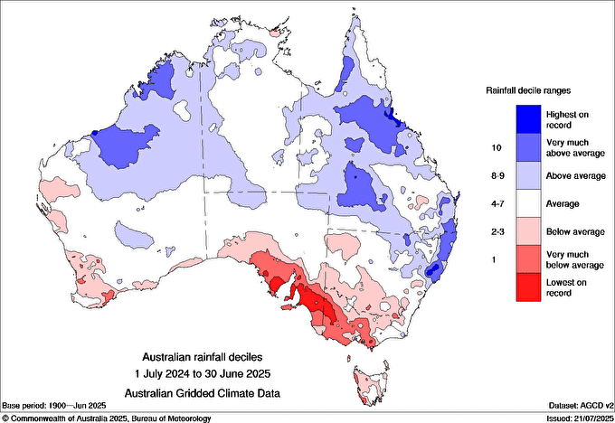
Notes:
To give you an idea of what that looks like, here is the Australian Bureau of Meteorology’s Climate data for the 12-month period July 2024 through to June 2025.
Blue is excessive rainfall – and red is little to no rainfall

Slide 6
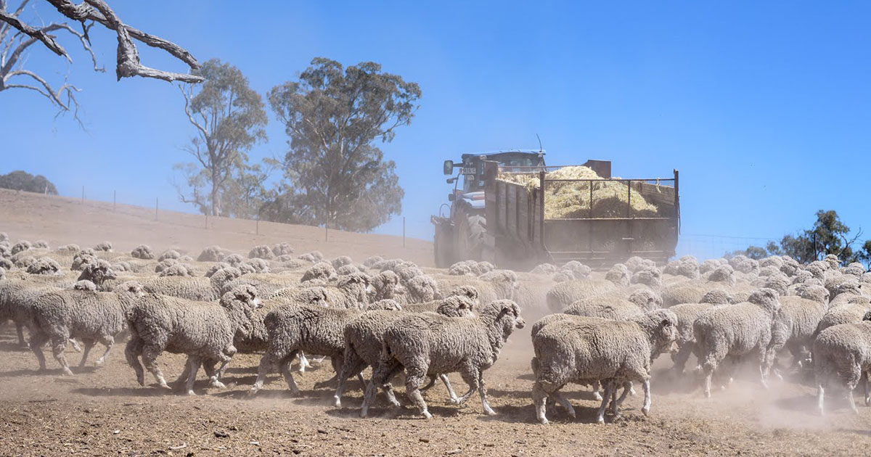
Notes:
Much of the southeast of Australia recorded the lowest rainfall on record. This means substantial supplementary feeding, carting water and off-loading livestock to the bare minimum. All while attempting to manage cash flows through to the next seasonal break.

Slide 7
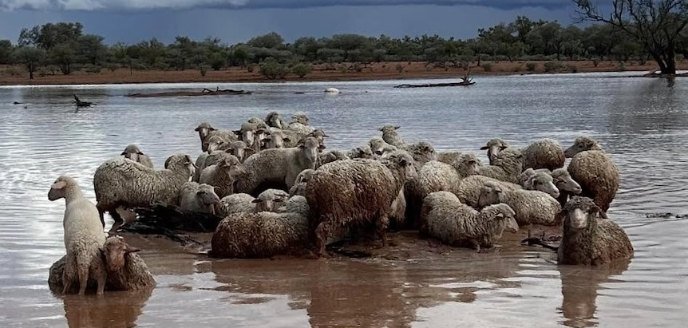
ABC: supplied - Henry Murray
Notes:
The blue ‘high rainfall’ area– can lead to extensive flooding and this can mean heavy livestock losses and infrastructure destroyed and washed away.
For example – back in March this year, in that south-west part of Queensland over 200,000 livestock and 8,000km of fencing were lost.

Slide 8
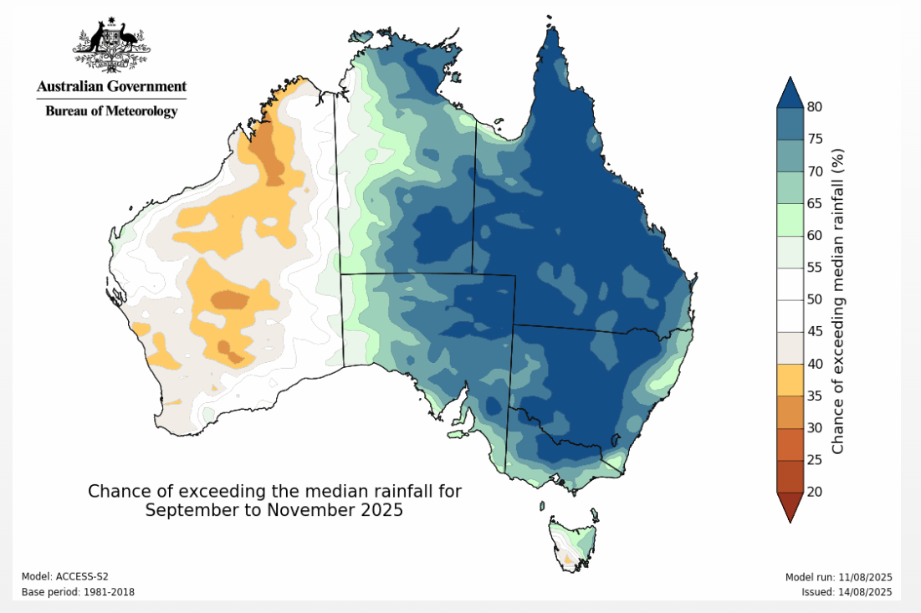
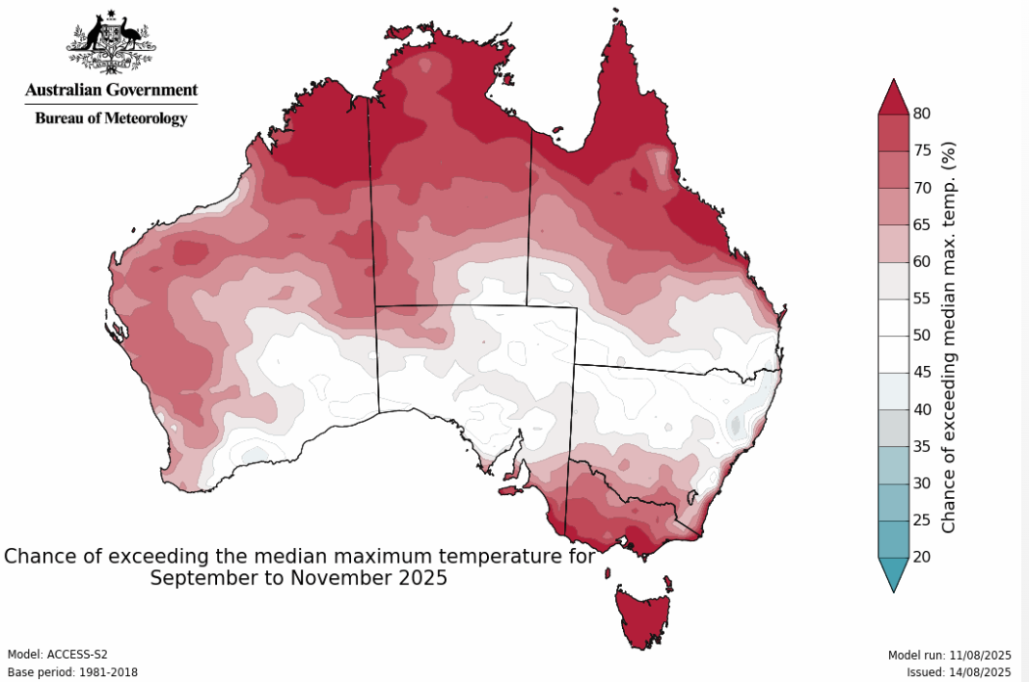
CLIMATE OUTLOOK
Chance of exceeding median rainfall Sep to Nov 2025
Chance of exceeding median max temp Sep to Nov 2025
Expected weather for next 3 months, given long term average
 | QLD | NSW | VIC | TAS | SA | WA
Median Rainfall | Wetter | Wetter | Wetter | Average/Wetter | Wetter | Drier/Average
Median Max. Temp | Average/Hotter | Average/Hotter | Hotter | Hotter | Average/Hotter | Average/Hotter
Notes:
The climate outlook, as forecast by the Bureau signals a hot and wet spring/summer period, which will be another challenging time for many woolgrowers.

Slide 9

‘000kgs greasy
Notes:
Moving on to a breakdown of the Australian wool clip by micron, we can see the focus is on fine merino wool (17.5-19.5micron), with second clip in the broader meat and wool - dual purpose sector

Slide 10
CHANGE IN THE AUSTRALIAN WOOL CLIP
‘000kgs greasy
Notes:
And again looking back to the start of the 2000’s we can see the marked difference in the micron profile – which I will show here in 5-year steps compared to the 2000-01 season.

Slide 11
CHANGE IN THE AUSTRALIAN WOOL CLIP
‘000kgs greasy
Notes:
2005/06

Slide 12
CHANGE IN THE AUSTRALIAN WOOL CLIP
‘000kgs greasy
Notes:
2010/11

Slide 13
CHANGE IN THE AUSTRALIAN WOOL CLIP
‘000kgs greasy
Notes:
2015/16

Slide 14
CHANGE IN THE AUSTRALIAN WOOL CLIP
‘000kgs greasy
Notes:
And moving a decade ahead to 2024/25 – and what you can see here is not only the reduction in production – but the move by many woolgrowers to ‘get finer – or get out’

Slide 15
CHANGE IN THE AUSTRALIAN WOOL CLIP
Since 2000-01
19.6 to 24.5 micron DOWN 369mkg (83%)
‘000kgs greasy
Notes:
What this has meant is an 83% drop in the mid-micron ranges. 369 million kilograms of 19.5 to 24.5 micron wool is no longer produced each year.

Slide 16
CHANGE IN THE AUSTRALIAN WOOL CLIP
Since 2000-01
19.6 to 24.5 micron DOWN 369mkg (83%)
Since 2000-01
<19.6 micron UP 56.6mkg (49.5%)
‘000kgs greasy
Notes:
While production of wool finer than 19.5 micron has increased 49.5% - meaning 56.6 million kgs more of this is available each year.

Slide 17

Australian woolgrowers still focus on Merino fineness
QUALITY
Australia remains the largest exporter of wool to the world
QUANTITY
HS: 5101.11 - Greasy shorn wool, incl. fleece-washed wool, neither carded nor combed
Notes:
Australia however, still remains a consistent export supplier both in terms of QUANTITY and QUALITY to our overseas customers.

Slide 18
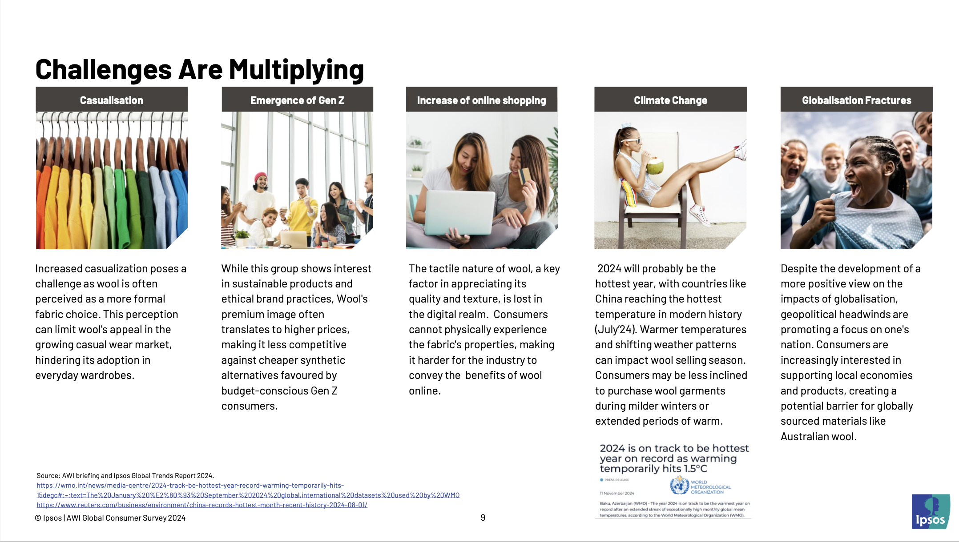


GLOBAL DEMAND FOR WOOL APPAREL
Casualisation
Emergence of Gen Z
Increase of Online Shopping
Increased casualisation
Budget-conscious Gen Z consumers.
Consumer cannot physically experience the fabric’s properties.
Climate Change
Eco Conscious Consumer
Cost of Living
Shifting weather patterns can impact wool selling season.
Eco-consciousness across Government, supply chains and consumers
Inflation remains the top global consigner.
Notes:
Understanding our end customer and investing in wool marketing has never been so important.
Consumer attitudes, global dynamics, how we shop & macro-economic pressures all shift and we need to keep abreast of these.
If we look at the changes over the past 10 years in major product categories, we see the drop in formal & business apparel – suits, jackets, trousers. But there is still strong demand for wool knitwear – including baselayer knits and both womens & mens coats. This is all part of a more casual and interchangeable style.

Slide 19
GLOBAL DEMAND FOR WOOL APPAREL
Notes:
The vast majority of Australian wool is destined for the apparel market. And while the supply chain journey is long, the final destination for these apparel products is with consumers in the countries shown here – measured in terms of the value of their wool apparel imports.
It’s worth noting here, this does not include China’s domestic manufactured apparel that is consumed in China – nor that say of Italian-made that is consumed in Italy.
This is purely imports

Slide 20
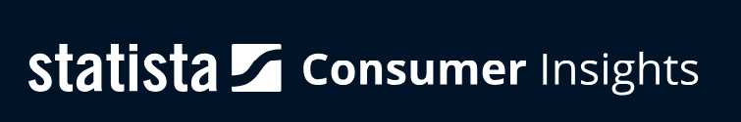
Question: “Out of the following, which are the most important aspects when choosing your apparel?” (multi-pick)
Top 10 Markets for Wool Apparel
Consumer Insights on the most important aspect when choosing apparel
(Q2 2025 Survey)
Notes:
To understand what influences the consumer’s purchase decisions in these top 10 markets, here are some consumer insights from the latest 2025 survey by Statista – who are one of the leading independent global data and business intelligence platforms.
The red bar is the range of responses within the top 10 countries, as some aspects such as price or style may be more important in some countries than in others.

Slide 21
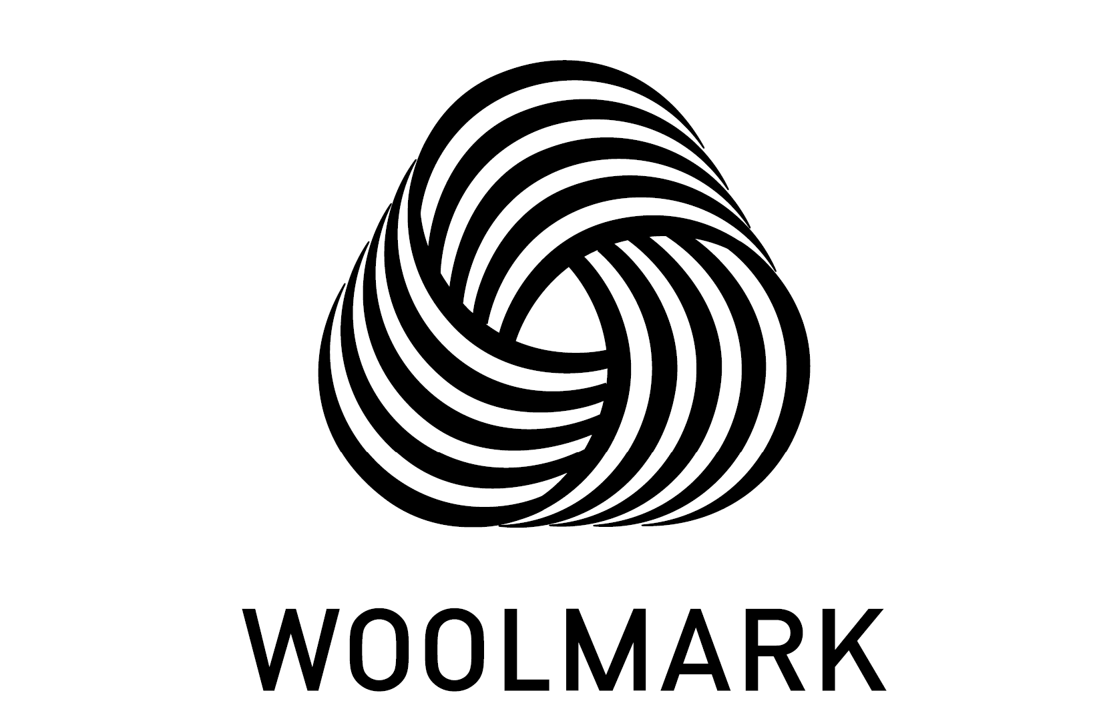
Question: “Out of the following, which are the most important aspects when choosing your apparel?” (multi-pick)
Top 10 Markets for Wool Apparel
Consumer Insights on the most important aspect when choosing apparel
(Q2 2025 Survey)
Notes:
However, the bottom line is aspects, such as comfort, quality, style, durability and material remain at the forefont of the consumers purchase decision in ALL key markets.
This is where the Woolmark marketing remains as relevant and as important as ever.

Slide 22



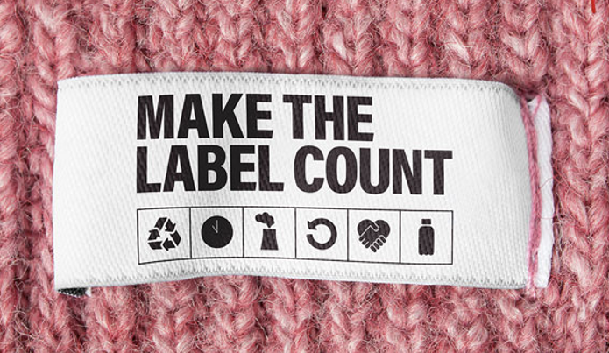
Accelerate
Expansion
Defend
The Core
Grow & Maintain
Reputation
Notes:
Our marketing efforts are built around 3 objectives:
We accelerate expansion through the growing performance sector - defend our core fashion categories - and grow and maintain wool’s reputation as a natural & environmentally friendly ‘fibre of choice’.
This third objective is a global collaborative effort and we acknowledge the extensive work the IWTO team put into this – and also the effort and commitments made by the Nanjing Wool Market and many others in this room today to help take on this fight against a lot of misinformation and greenwashing.

Slide 23
Summary
Challenging conditions continue for Australian woolgrowers – but we remain the major wool supplier to the world
Committed to growing the quality fine Merino wool to meet customers’ requirements
Through the Australian-owned Woolmark Company we continue to forge partnerships that market and promote to build demand for ALL wool.
Notes:
So just in summary – for Australian woolgrowers, there are many challenges – but they remain resilient, passionate and proud about the wool they produce – and the sheep they breed.
They stay committed to doing their part in lifting demand – and they do this through their continued investment in Woolmark marketing and promotional efforts globally.
And we look forward to a strong and collaborative future!

Slide 24
Notes:
Thankyou!

